Slide 1

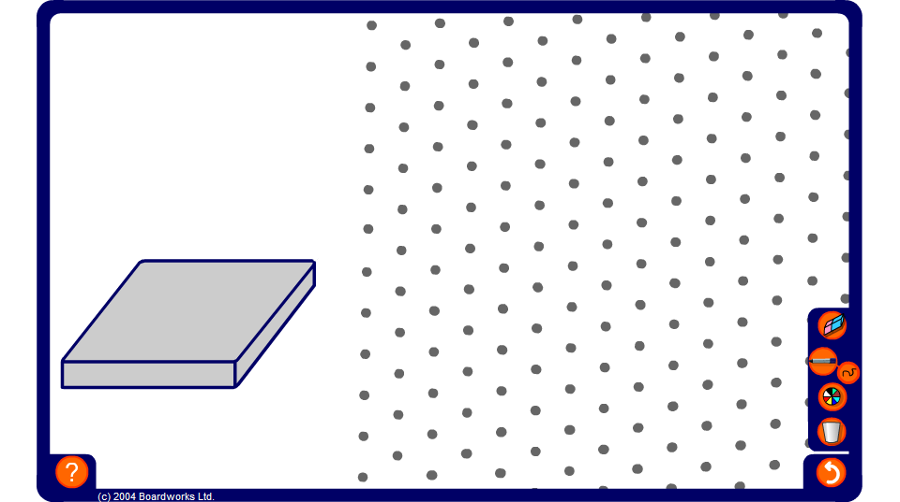


Drawing 3-D shapes on an isometric grid
Notes:
Use this activity to practice and to demonstrate isometric drawings of 3-dimensional shapes made from cubes.
Use the pen tool, set to draw straight lines, to draw the required shape on the grid.
As a more challenging exercise ask pupils to draw the given shape in different orientations of with extra cubes added in given positions.

